Slide 1
Advanced skills in R UBC Library Research Commons
November 28 2022
Jared Connoy, Ashley Yue Mao
Please ensure you have R, and R studio installed on your computer
Let us know if you need assistance with setup

Slide 2
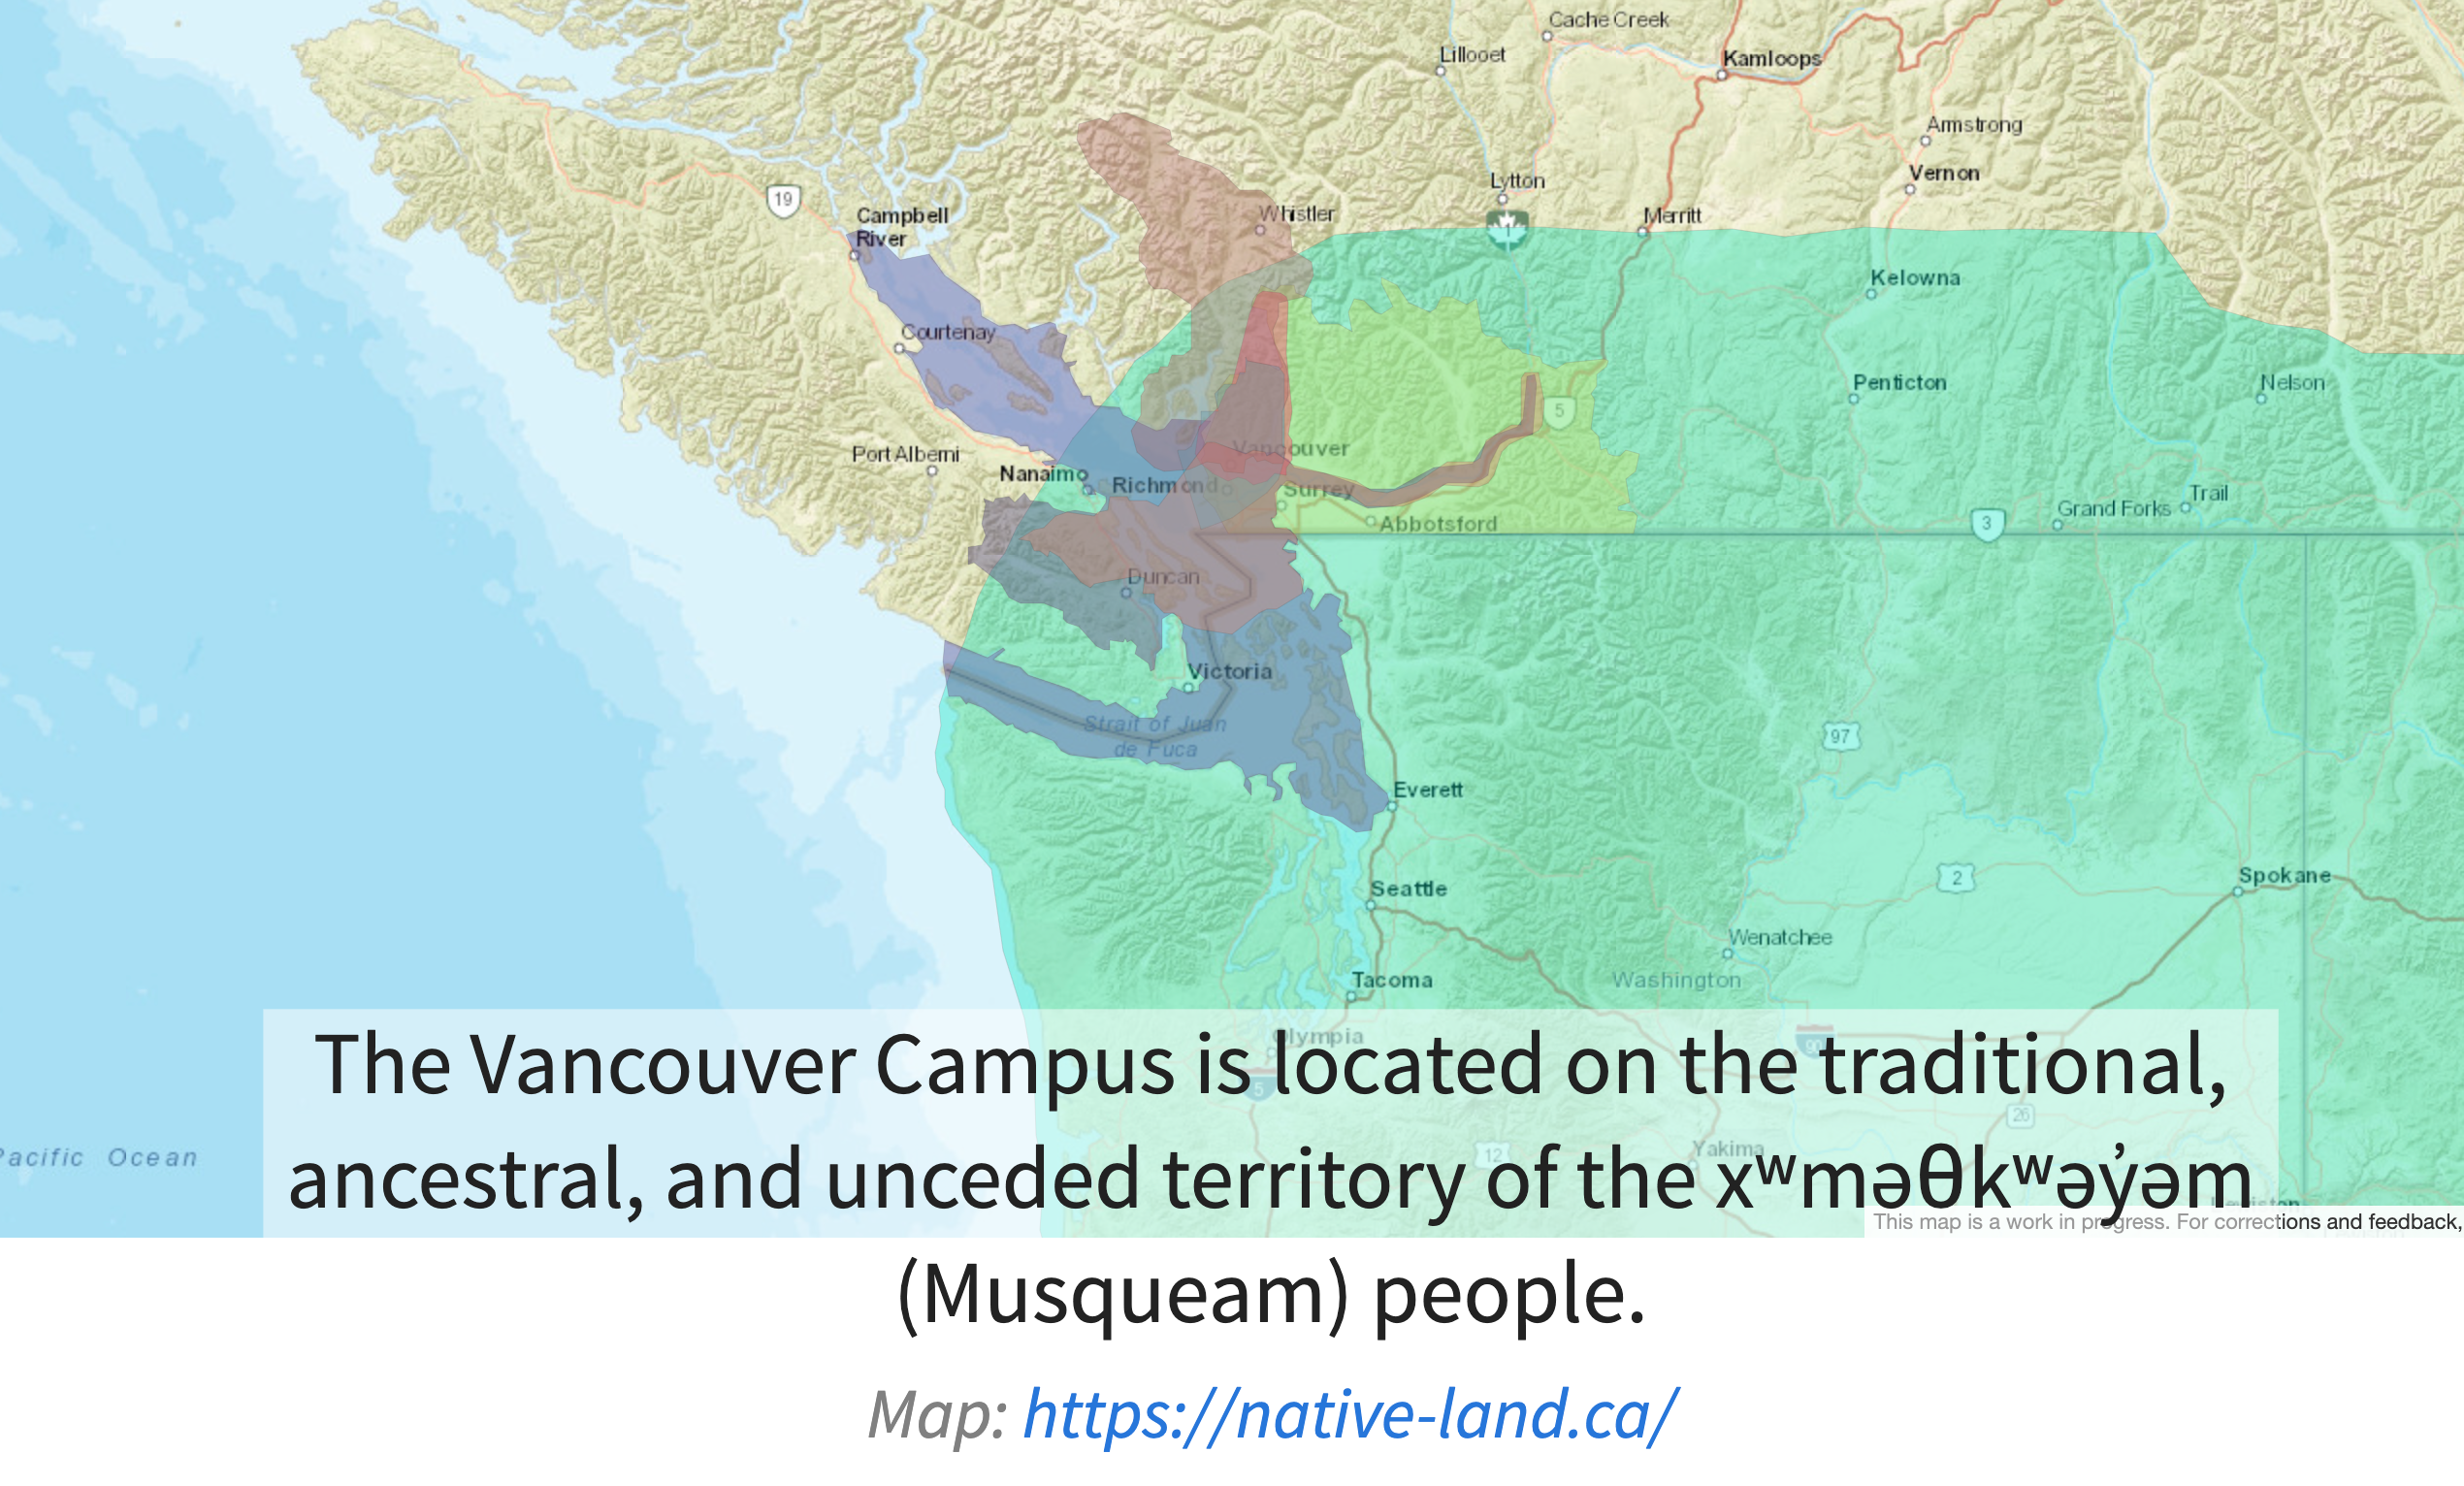

Slide 3

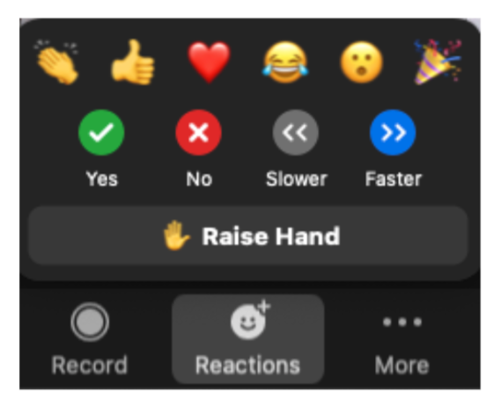

Participating in zoom

Slide 4
Welcome to the workshop!
Introductions (Ashley/Jared)
Workshop will be recorded and shared
Workshops and consultations
When to use the chat
Workshop file/materials

Slide 5
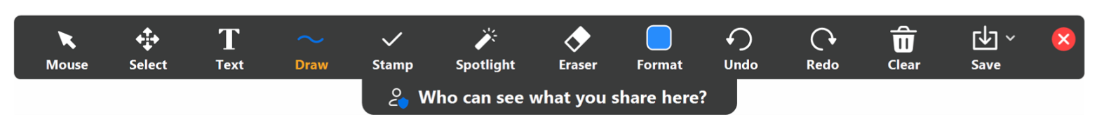
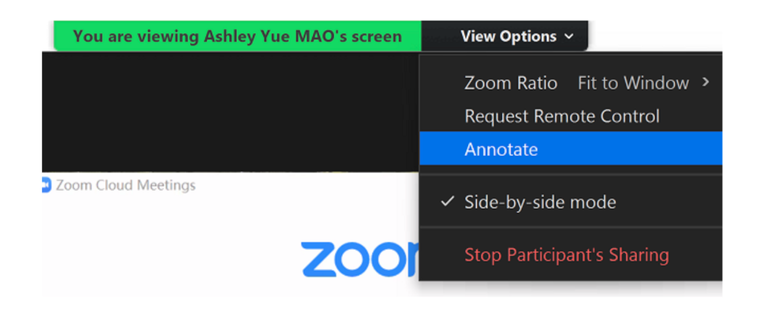
Annotate

Slide 6
high
Experience in R
low
high
low
Experience in other programming language(s)

Slide 7
Learning objectives
Perform advanced, custom operations in R to manipulate and analyze data
Expand knowledge, capability, and flexibility with base R
Be able to create a for loop, nested loop, conditional statement, and custom function
*Certain level of knowledge/skill may be required to follow along in this workshop

Slide 8
Outline
For loops (40min)
Nested for loops (20min)
Break (5-10min)
Conditional (if/else) statements (20min)
Custom functions (20min)

Slide 9
Workshop format
Working in R Studio
Using an R markdown (.rmd) file. Allows for:
Regular text writing
Code to be separated into ‘chunks’
Inline output

Slide 10
What is a for loop?
for (i in x){
perform some operation using each value of x
}
x could be a vector, list, matrix, or any other sequence of values/objects
i stands for iteration, and is set to each value of x in each iteration of the loop

